Slide 1
NAME: PATEL PRINCEKUMAR GULABBHAI
ENROLLMENT: 230840131117
STREAM: COMPUTER SCIENCE & ENGINEERING
COLLEGE: R.N.G. PATEL INSTITUTE OF TECHNOLOGY(RNGPIT)
DATE:06/07/2026

Slide 2
THINGS I LERANED FROM THE LINKS
Sustainable Development Goals (SDGs)
The 17 SDGs aim to achieve sustainable development by 2030.
My favorite SDG: SDG 17 – Partnerships for the Goals
Encourages collaboration between governments, industries, and individuals.
Supports innovation and global sustainability.
AI Data Center Documentary
AI data centers consume huge amounts of electricity and water.
AI growth increases energy demand and carbon emissions.
Green AI practices include:
Renewable Energy
Efficient Cooling Systems
Energy Optimization

Slide 3
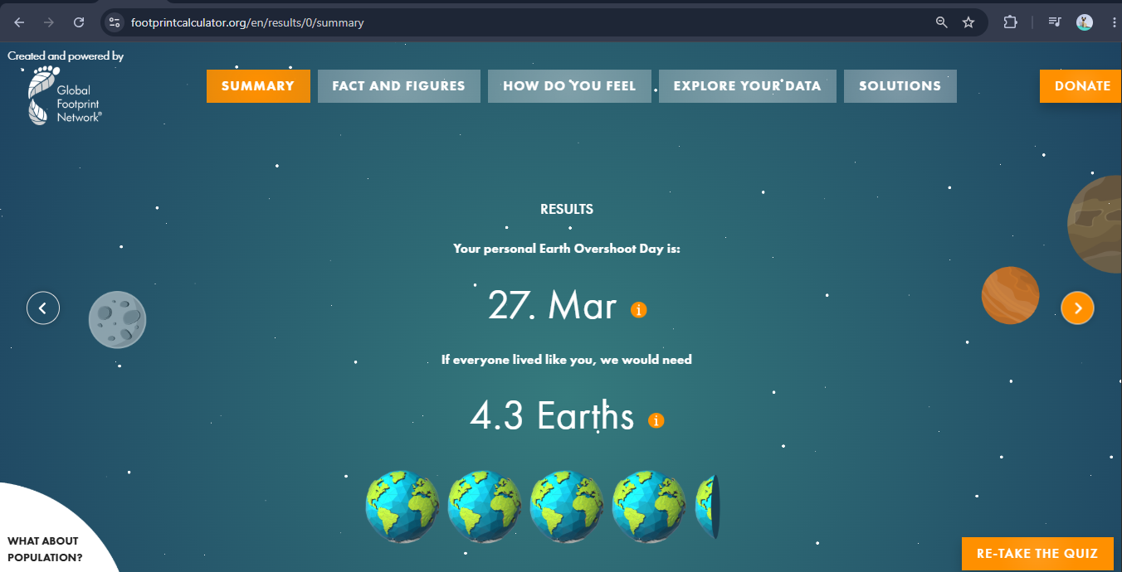
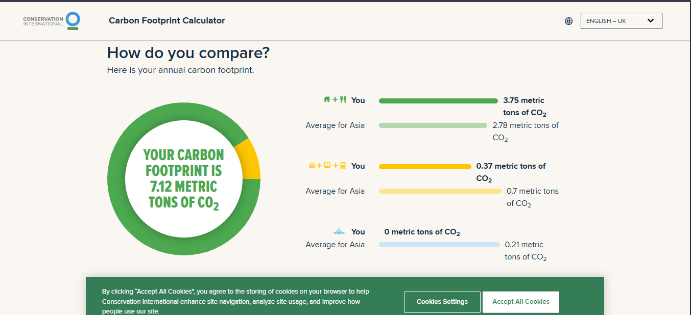
Ecological Footprint Calculator
Personal ecological footprint
Carbon Footprint Calculator
Household emissions
Transportation emissions

Slide 4
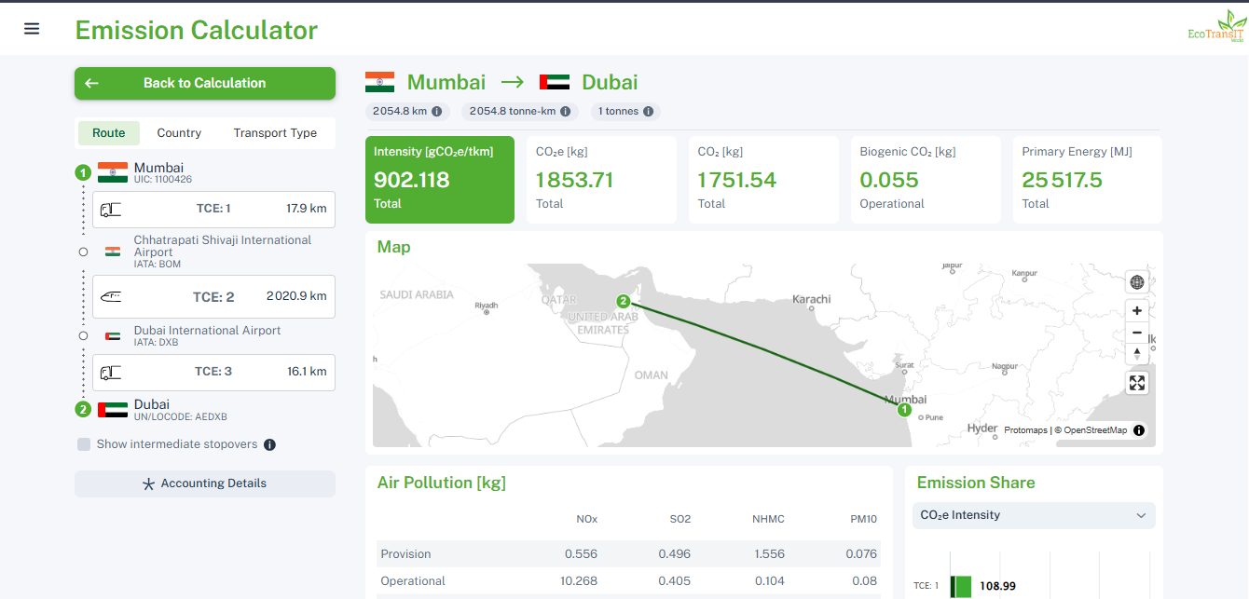
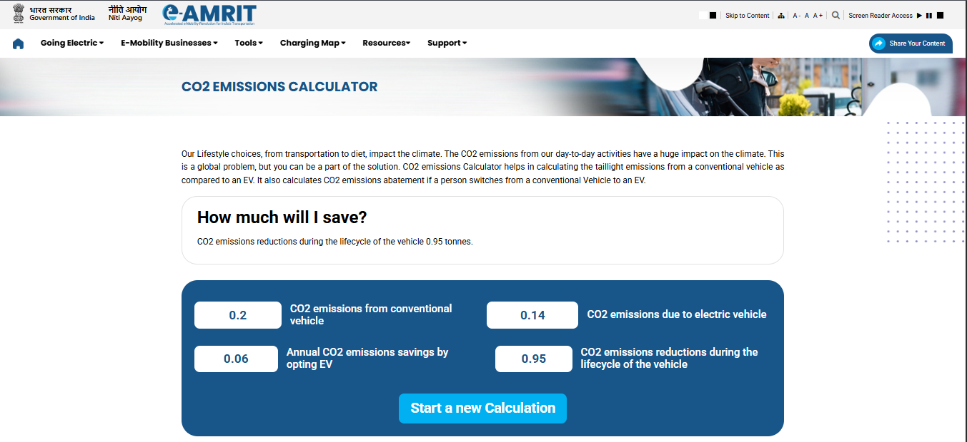
EcoTransit CO₂ Calculator
Comparison of transport emissions
e-AMRIT CO₂ Calculator
Vehicle emission analysis

Slide 5
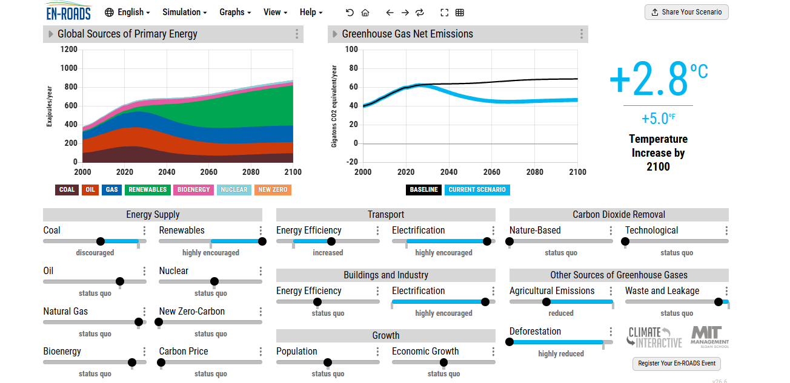
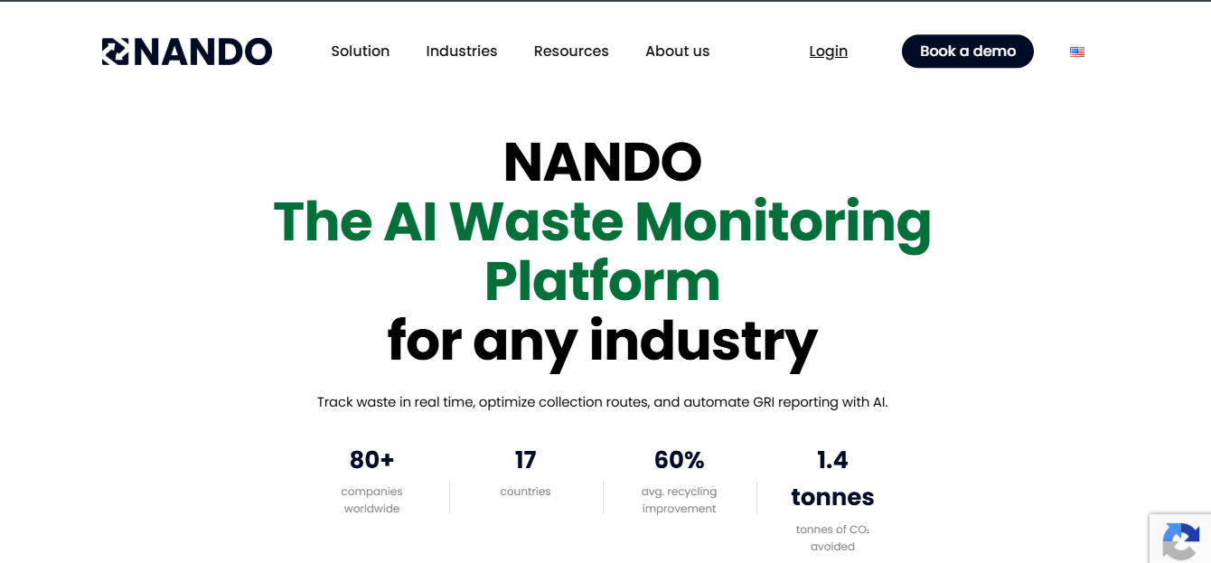
En-ROADS Climate Simulator
Climate policy simulation
NANDO AI
AI-powered waste monitoring

Slide 6
Green Skilling, Sustainability & AI
Green Skilling
Develops eco-friendly knowledge and practical skills.
Creates employment in green industries.
Promotes sustainable practices.
Sustainability
Balances People, Planet, and Prosperity.
Conserves natural resources.
Supports long-term environmental protection.
AI for Sustainability
Smart waste management
Precision agriculture
Energy optimization
Carbon emission analysis
Challenges
High energy consumption
Water usage in data centers
Electronic waste
Carbon emissions from AI infrastructure

Slide 7
CAPSTONE PROJECT - AI Campus Sustainability Dashboard
Problem Statement
Educational institutions often lack a centralized system to monitor electricity usage, water consumption, waste generation, and sustainability performance.
Proposed Solution
Develop a dashboard that tracks campus sustainability metrics and provides AI-driven recommendations for improvement.
AI Component
Predictive analytics and anomaly detection.
Related SDGs: 11, 12, 13, 17

